Slide 1

TimeTable Assisstant
INF 272 PROJECT

Slide 2
Group Members
Yi-Yu (Bruce) Liu
Christopher Park
Duran Cole
Kristina Jovanovic
Nonde Masondo

Slide 3
Storyboard

Slide 4

This is Andy.
He started studying at UP in 2012.
This is him working out his timetable…

Slide 5
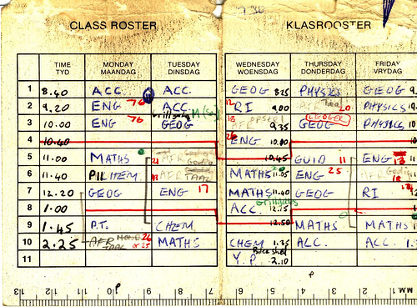
This is Andy’s final timetable:

Slide 6

This is Sally.
She started studying at UP in 2014.
She discovered the
TimeTable Assistant.

Slide 7
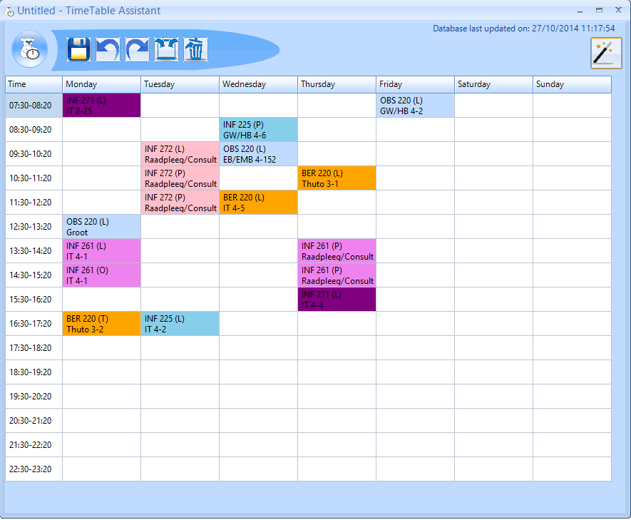
This is Sally’s final timetable:

Slide 8
All Sally had to do was…
Type in her student number and password,
Go through the wizard,
and BAM!
Timetable complete.

Slide 9
The program provides…
…a variety of timetable options to choose from,
the choice between early classes or late classes,
the test schedule for the year,
the synchronisation between her lecture timetable, test timetable and personal events on Google Calendar.

Slide 10
Project Description
TimeTable Assisstant is a program that helps students compile their lecture and test timetable for a given semester or year of their studies.
The user simply enters their module codes into the program, and VOILA:
Lecture times
Lecture venues
Possible clashes
Different groups
ALL GIVEN!

Slide 11
Motivation for Project
Time consumption - countless hours spent compiling a timetable manually.
General confusion - the red timetable book provided by the university isn’t updated.
First year students – no knowledge of the venues.

Slide 12
Program Functionality

Slide 13
Advanced OOP Techniques

Slide 14
Polymorphism
Casting
Memento design pattern
Deep-copying done
Binding Lists
Save and/or Load of the timetables

Slide 15
Inheritance
Used to separate
Personal events and
UP modules

Slide 16
Binding Lists
Save and/or Load of the timetables.

Slide 17
Database Connectivity

Slide 18
Connection
Use of UP schedule database to retrieve:
UP module schedule
UP semester test schedule

Slide 19
Stand-Alone Components
Icons as buttons
Right-click function

Slide 20
Extra Features

Slide 21
XML
Data structures
Design Patterns
Google Calendar API
Map display
Export to Excel
Export to image

Slide 22
Recursive functions
Portal Login through web browser
Download of .csv files
Converting .csv files to access database
Rename, create, delete files
Deep copying of classes
Threading processes

Slide 23
2D-Arrays
Timers
Skins (for GUI)
Krypton
Telerik

Slide 24
THE END

